Slide 1
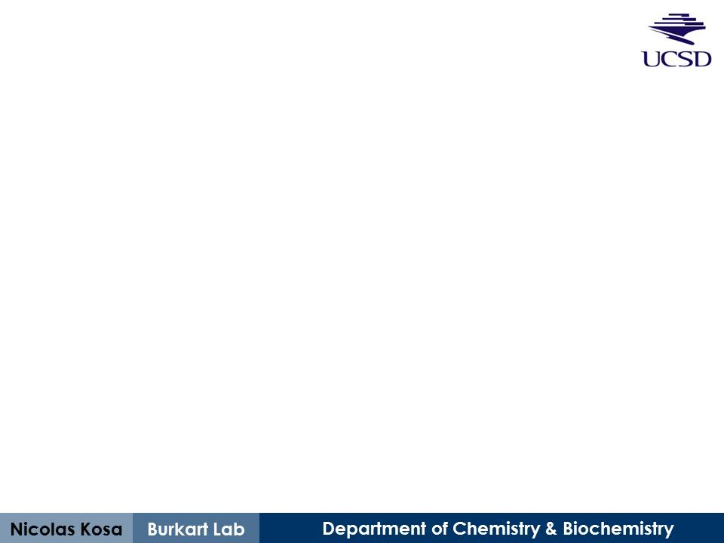
Developing short peptides for reversible and specific labeling
Biocatalyst Subgroup
March 2013

Slide 2
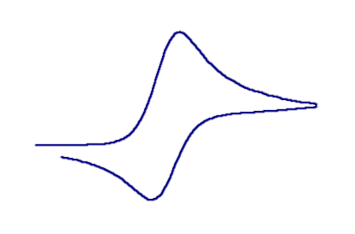
Dream scenario, solid phase
= misc
label
XXXSXXXXXXXXX
PPTase
XXXSXXXXXXXXX
AcpH
XXXSXXXXXXXXX
“Ybbr-type” peptide
“Sample CV #1a”
“Sample CV #2”
“Sample CV #1b”
Notes:
PPTase = phosphopantetheinyl transferase
The PPTase Sfp has been shown previously to both promiscuously accept modified coenzyme A, as well as diverse carrier protein substrates including minimal peptides such as “Ybbr”. Appends phosphopantetheine to a conserved serine in all substrates.
AcpH = acyl carrier protein hydrolase
AcpH cleaves the phosphopantetheine from carrier proteins. It exhibits promiscuity for modified phosphopantetheine but does not currently exhibit the level of promiscuity for carrier protein substrates compared to Sfp. Our big goal for this system is to find a minimal peptide that works for both Sfp and AcpH.

Slide 3
Dream scenario, solution-phase
= misc
label
XXXSXXXXXXXXX
PPTase
XXXSXXXXXXXXX
AcpH
XXXSXXXXXXXXX
Possible morphology changes
Notes:
PPTase = phosphopantetheinyl transferase
The PPTase Sfp has been shown previously to both promiscuously accept modified coenzyme A, as well as diverse carrier protein substrates including minimal peptides such as “Ybbr”.
AcpH = acyl carrier protein hydrolase
AcpH cleaves the phosphopantetheine from carrier proteins. It exhibits promiscuity for modified phosphopantetheine but does not currently exhibit the level of promiscuity for carrier protein substrates compared to Sfp. Our big goal for this system is to find a minimal peptide that works for both Sfp and AcpH.

Slide 4
Existing short peptide PPTase substrates
Ybbr does not work with AcpH currently
Zhou, et. al. (2007) ACS Chem. Biol “Genetically Encoded Short Peptide Tags for Orthogonal Protein Labeling by Sfp and AcpS Phosphopantetheinyl Transferases”

Slide 5
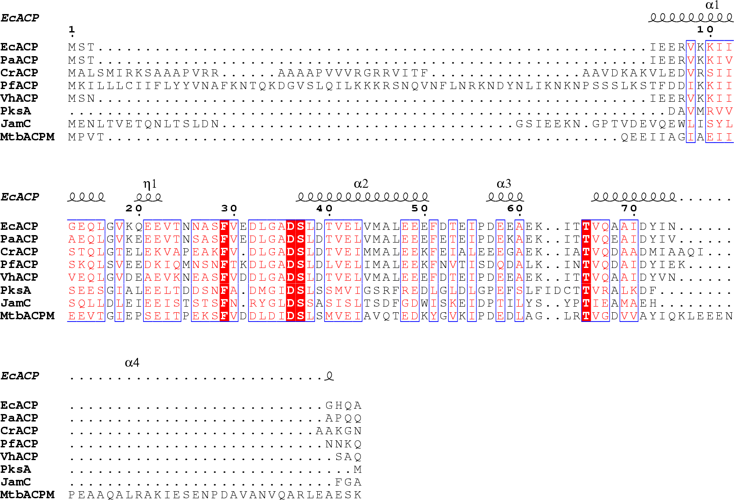
Known AcpH-compatible substrates
(aligned to known substrate structure, E. coli AcpP “EcACP”)
T-Coffee alignment & ESPript structure map to E. coli ACP
bis-pNPP
2’,3’-cAMP
Notes:
AcpH displays phosphodiesterase/hydrolase activity against aligned carrier proteins depicted here, as well as the phosphodiesterase standards bis-pNPP (4-nitrophenyl phosphate bis) and 2’,3’-cAMP (cyclic adenosine monophosphate)
Phosphopantetheine is attached to the identically conserved serine in red.

Slide 6

Previous AcpH homology modeling
E. coli AcpH modeled after SpoT
Thomas, Rigden & Cronan (2007) Biochemistry “Acyl Carrier Protein Phosphodiesterase (AcpH) of Escherichia coli Is a Non-Canonical Member of the HD Phosphatase/Phosphodiesterase Family”
Notes:
Previously reported structure comparison of E. coli AcpH to a known phosphodiesterase “SpoT” allows a loose idea of AcpH structure

Slide 7
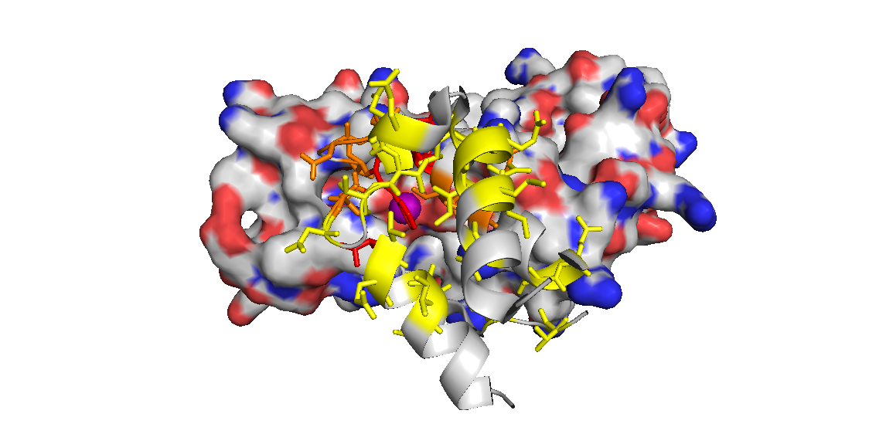
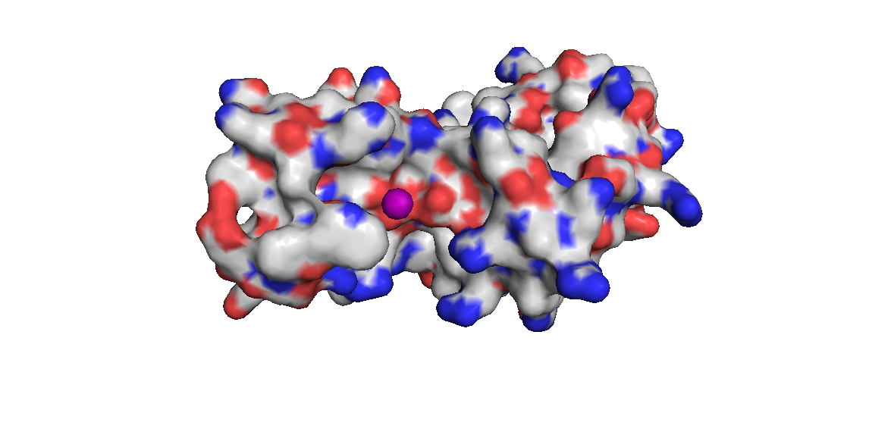
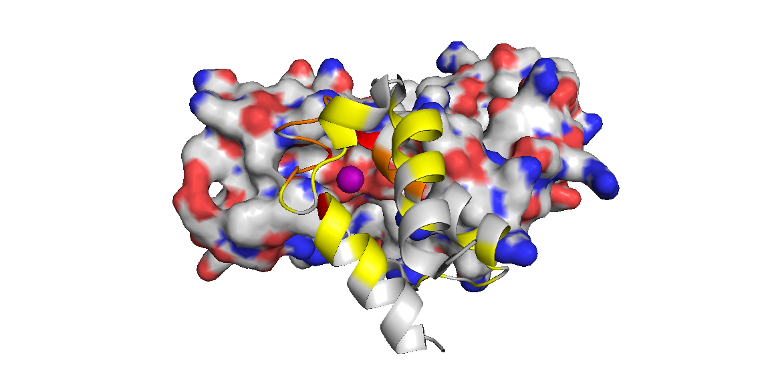
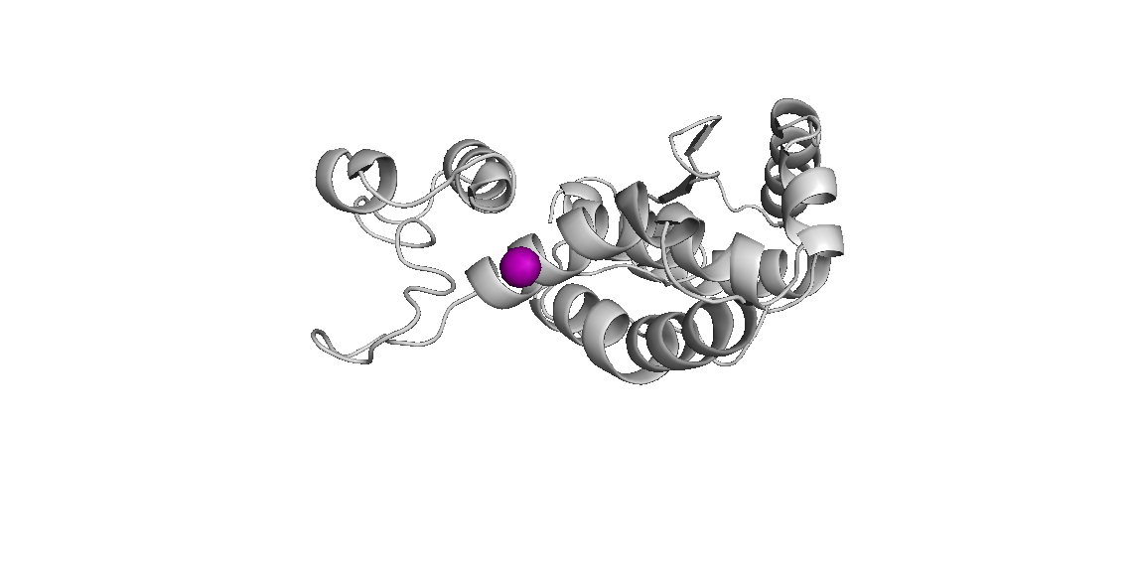

PaAcpH homology structure
Identical
Conserved <10AA from Ser
Conserved >10AA from Ser
Pseudomonas aeruginosa AcpH modeled after SpoT (thanks to Joris Beld!)
Notes:
Mapping P. aeruginosa AcpH (the AcpH used in our studies, due to increased stability) onto known phosphodiesterase “SpoT” allows a loose idea of PaAcpH structure
The conserved residues from carrier protein structure alignment on previous slide are depicted here, as mapped onto E. coli ACP, which is manually docked to the AcpH (auto-docking gave mixed/illogical results)
These results indicate conservation on a particular ‘face’ of the ACP, even though the 4 identically conserved residues possessed spacing across multiple helices.

Slide 8
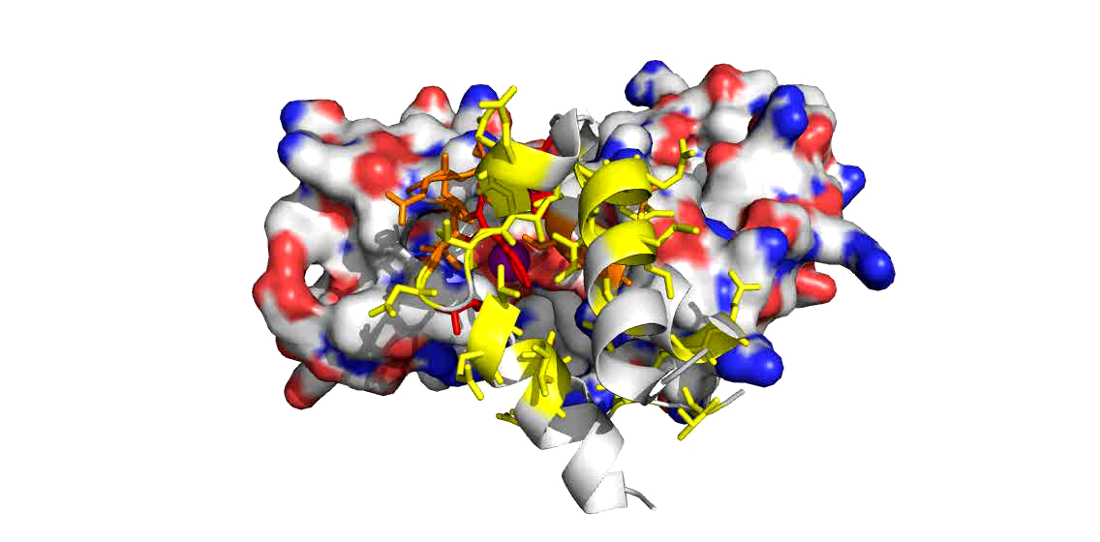
Identical & conserved substrate residues
Identical
Conserved <10AA from Ser
Conserved >10AA from Ser
Click to play movie
Manually-docked E. coli ACP
Notes:
Mapping P. aeruginosa AcpH (the AcpH used in our studies, due to increased stability) onto known phosphodiesterase “SpoT” allows a loose idea of PaAcpH structure
The conserved residues from carrier protein structure alignment on previous slide are depicted here, as mapped onto E. coli ACP, which is manually docked to the AcpH (auto-docking gave mixed/illogical results)
These results indicate conservation on a particular ‘face’ of the ACP, even though the 4 identically conserved residues possessed spacing across multiple helices.

Slide 9
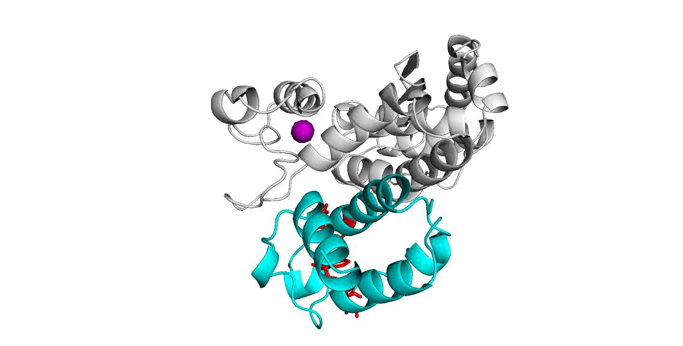
PaAcpH/EcACP autodock
Thanks to Joris Beld!
Click to play movie

Slide 10
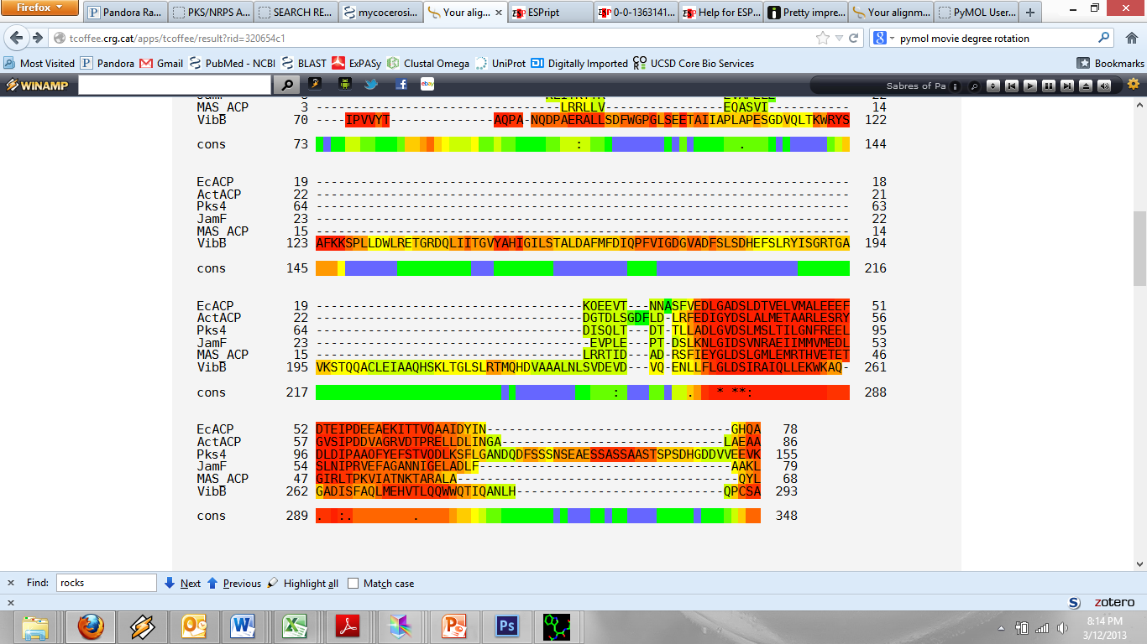
Known AcpH-incompatible substrates
(aligned to a known substrate, E. coli AcpP “EcACP”)
No conserved phenylalanines in non-substrates
Notes:
The most notable difference between the incompatible substrate ACPs compared to compatible substrates is the distinct lack of a phenylalanine upstream of the “DS” active site

Slide 11
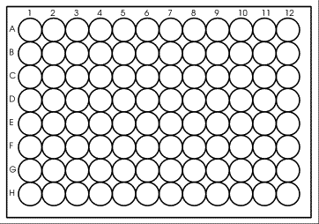
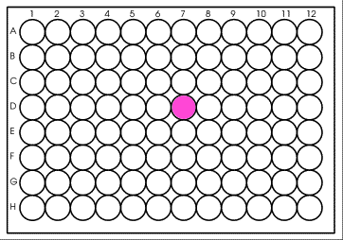
Generate peptide libraries & label
XXXFXXXXXDSXXXXX
rCoA
EDTA
PPTase
gAcpH
Peptide Library
Labeled Peptide,
Total “r” Signal
Labeled Peptide,
“g-r” Binding Signal
Notes:
The current plan is to create a basic peptide scaffold using our current understanding of residue conservation for AcpH substrates, and vary the intervening amino acids in a solid-phase peptide synthetic array.
These peptides must first be labeled by a PPTase, and detected. Logically we should use a cocktail of PPTases, and not limit ourselves to Sfp. Various Sfp-types and AcpS types (particularly S. coelicolor AcpS) should be used.
Next we would test binding (higher throughput) with AcpH-GFP, followed by activity (low throughput)

Slide 12
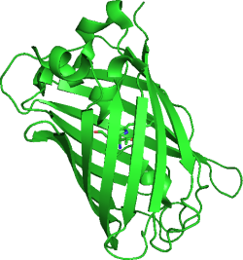




Studying PPTase/AcpH activity (FRET)
Increasing peptide screening throughput with FRET
=
=
rhodamine
Green Fluorescent Protein (GFP)
or Fluorescein
λ₃
+
DETECT
λ₁
λ₂
λ₁
AcpH
DSLEFIASKLA
DSLEFIASKLA
DSLEFIASKLA
XXXSXXXXXXXXX
Sfp
XXXSXXXXXXXXX
XXXSXXXXXXXXX
fusion peptide
Notes:
Background info for this assay technique as used in the Burkart Lab:
Ybbr is the minimalized CP substrate with sequence DSLEFIASKLA → genetically conserved active site of carrier protein recognized by Sfp
Ybbr was identified by Walsh in 2005 through phage display with sfp activity assay
This assay format is published in high detail for rhodamine/fluorescein (doi:10.1016/j.ab.2009.06.037 ), as well as brief demonstration for rhodamine/GFP (DOI:10.1038/NMETH.2175)

Slide 13
Studying peptide/AcpH binding (FRET)
Increasing peptide screening throughput with FRET
=
=
rhodamine
Green Fluorescent Protein (GFP)
λ₃
DETECT
λ₂
λ₁
λ₁
AcpH
AcpH
DSLEFIASKLA
DSLEFIASKLA
DSLEFIASKLA
XXXSXXXXXXXXX
Sfp
XXXSXXXXXXXXX
XXXSXXXXXXXXX
free peptide
EDTA
Binding (no activity!)
Notes:
We currently have AcpH-GFP expressed and purified, but need to assess activity/binding before this method is validated.

Slide 14
Moving forward…
Need to validate AcpH-GFP substrate FRET signal upon rhodamine-pantetheine labeled carrier protein (with 1 week)
Need to learn and test spot-peptide synthesis array
Need to determine initial peptide scaffold to be used for spot-peptide synthesis
Based on alignment of currently known peptides
Also consider peptide “A1” from Zhou, et. al. (AcpS substrate)

